Slide 1
Introduction to Bioinformatics
In the name of the most high
Microarray, NGS
Ali Sharifi-Zarchi
Department of Computer Engineering, Sharif University of Technology
These slides are available under the Creative Commons Attribution License.

Slide 2


Biodiversity
http://www.greenrooftechnology.com/biodiversity

Slide 3
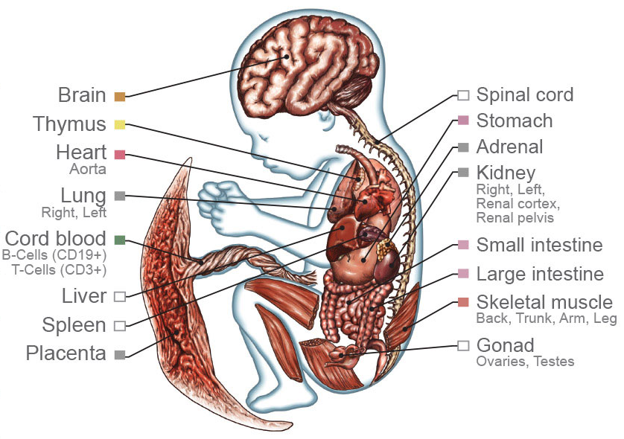
Differentiation
http://www.nih.gov/news/health/feb2015/images/niehs-18_xl.jpg

Slide 4

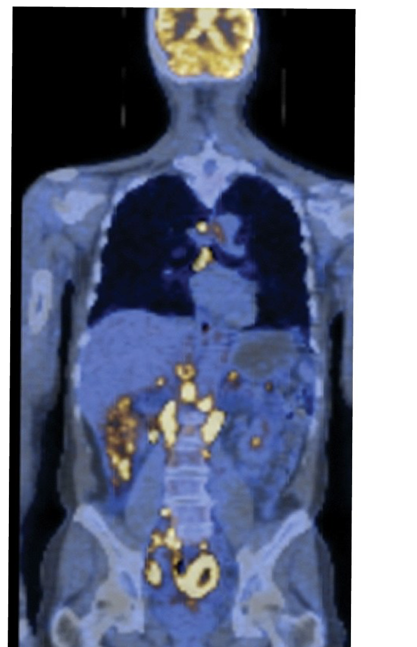
Disease
http://cdn1.medicalnewstoday.com, The Biology of Cancer (© Garland Science 2007)

Slide 5
What to Read?

Slide 6
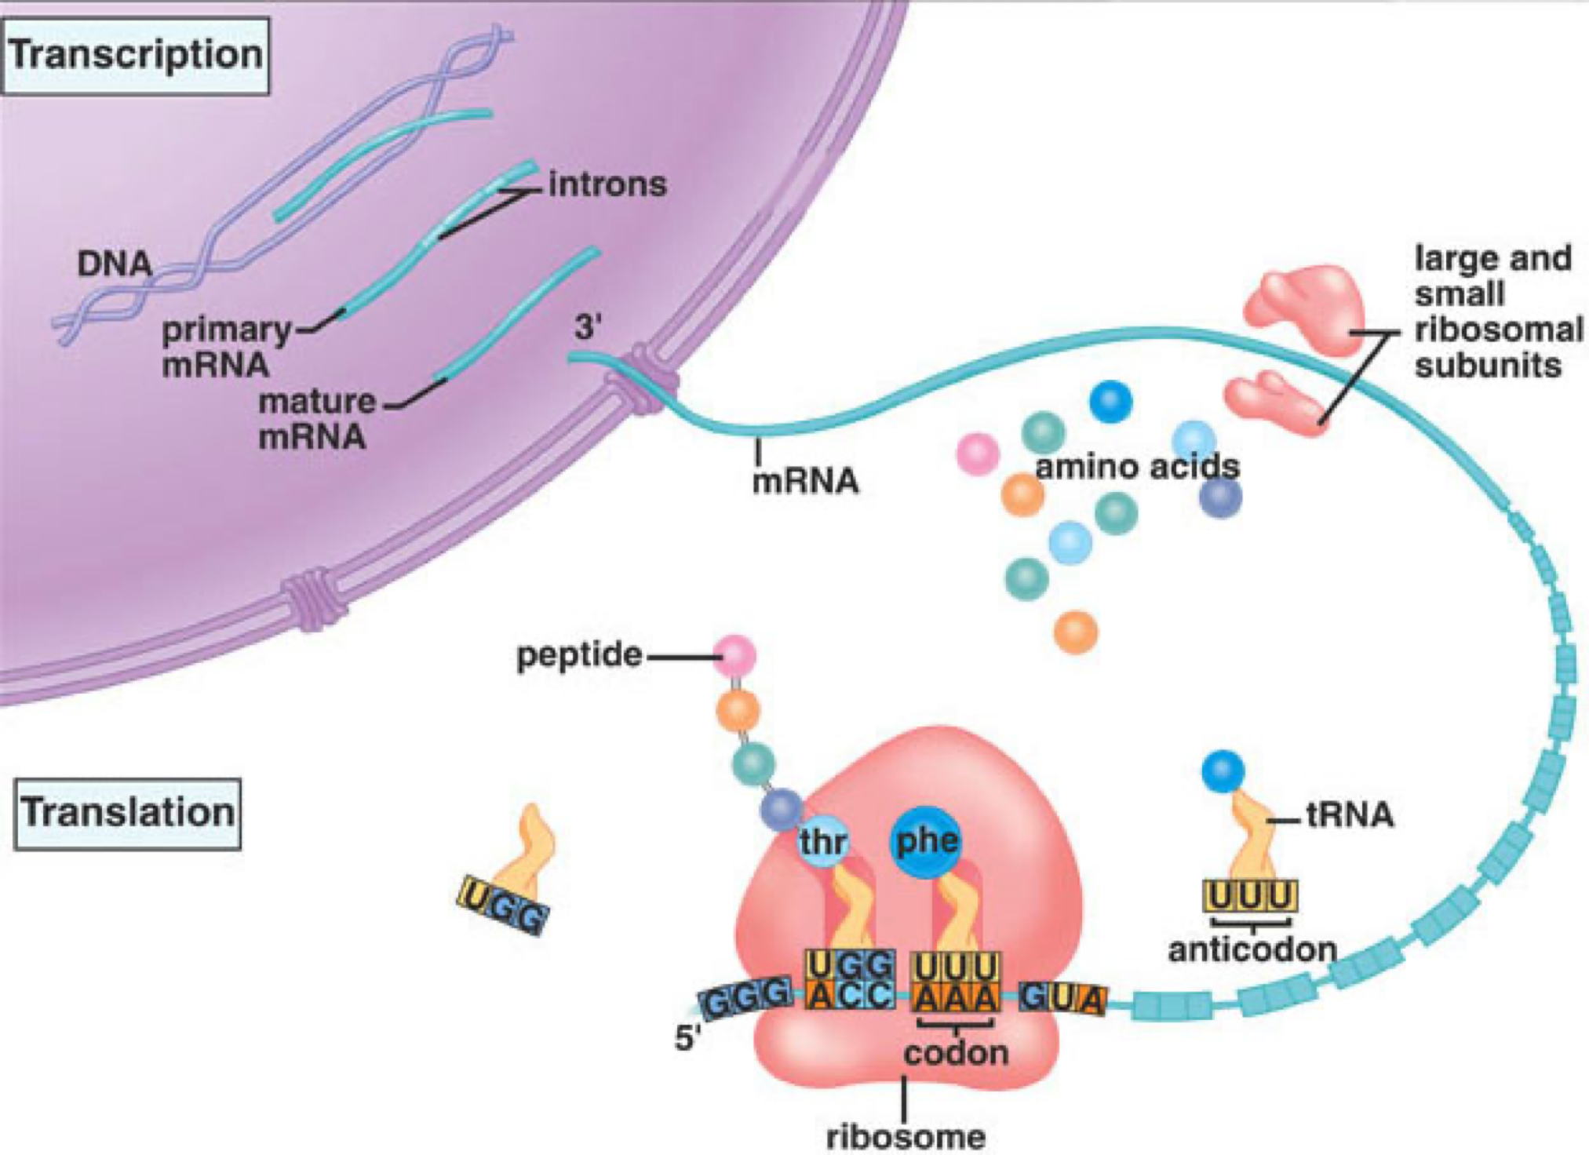
What to Read?

Slide 7
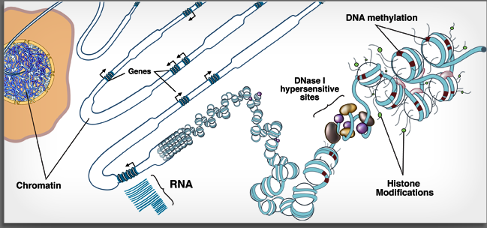
What to Read

Slide 8
How to Read?

Slide 9

Technologies
PCR
Microarray
Sequencing (Next-Generation)
http://www.pngall.com

Slide 10
PCR

Slide 11
PCR
https://en.wikipedia.org/wiki/Polymerase_chain_reaction

Slide 12
qPCR

Slide 13
qPCR
www.affymetrix.com

Slide 14
qRT-PCR
en.wikipedia.org/wiki/Reverse_transcription_polymerase_chain_reaction

Slide 15
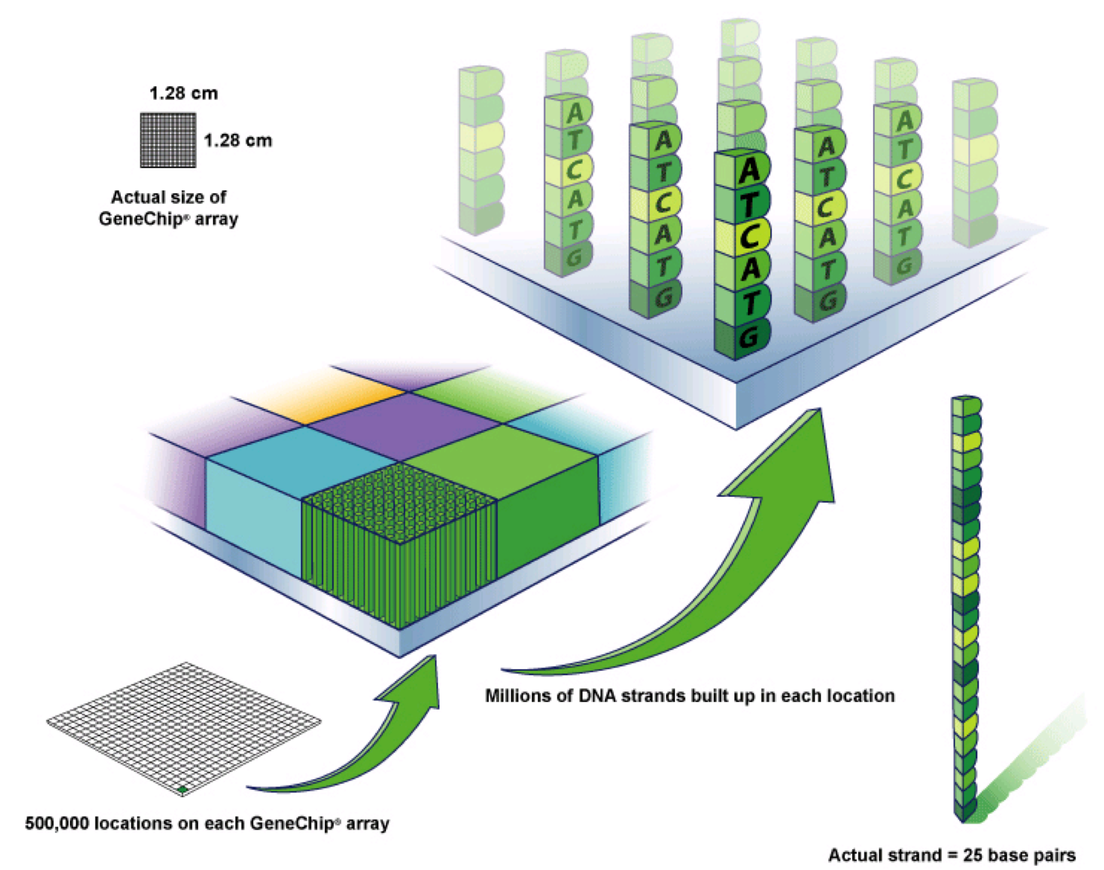
Microarray

Slide 16
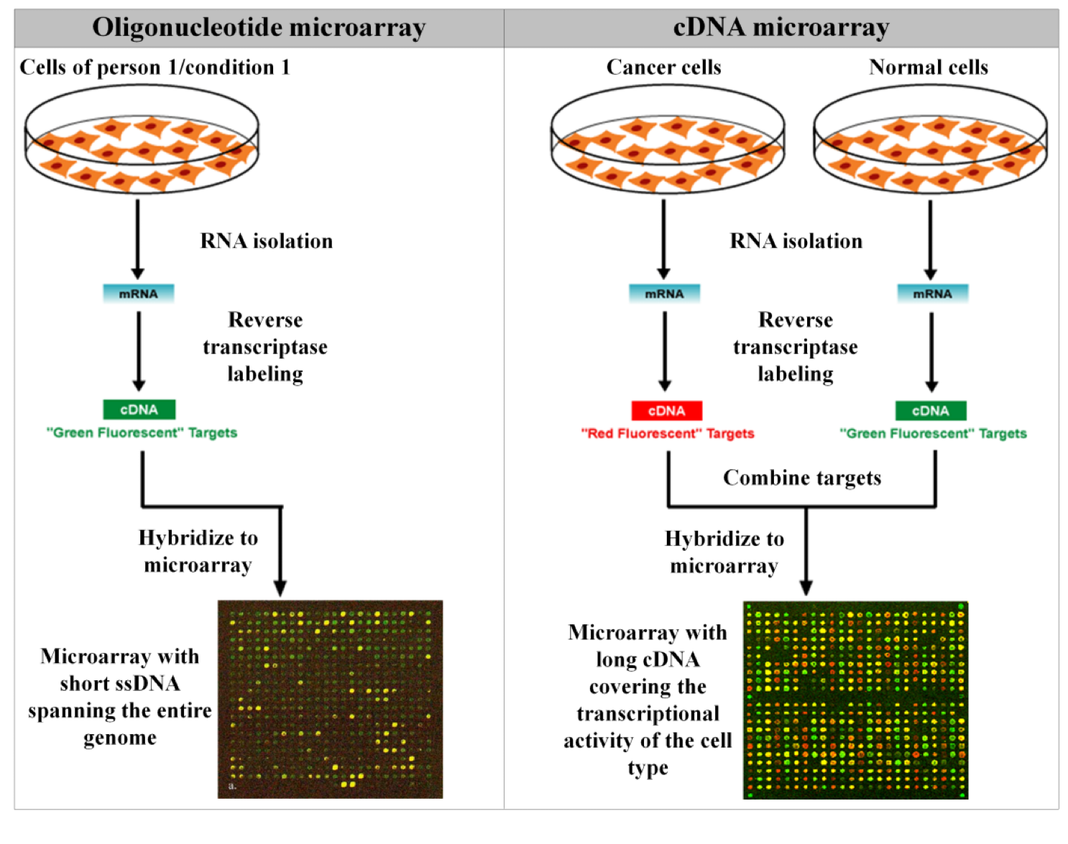
Microarray

Slide 17
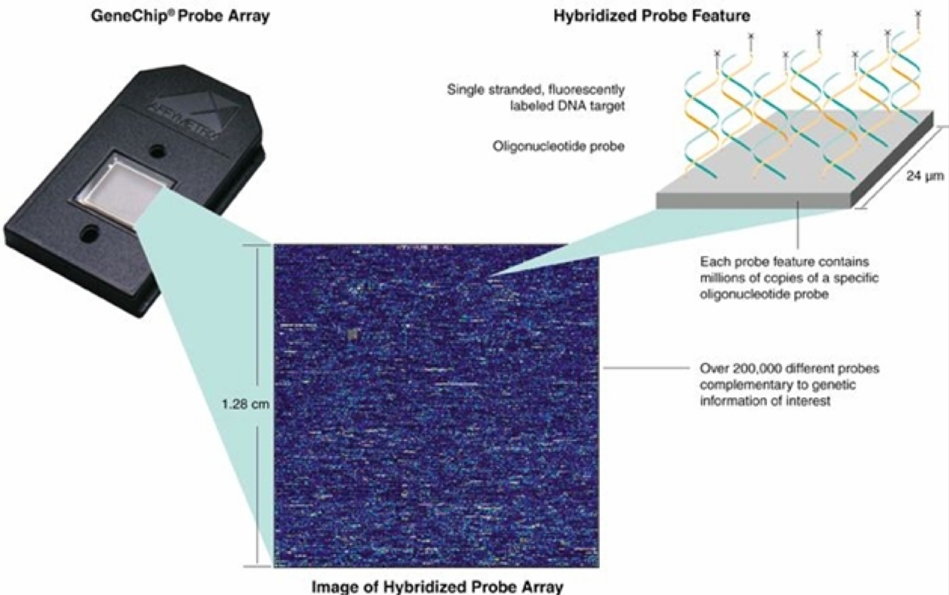
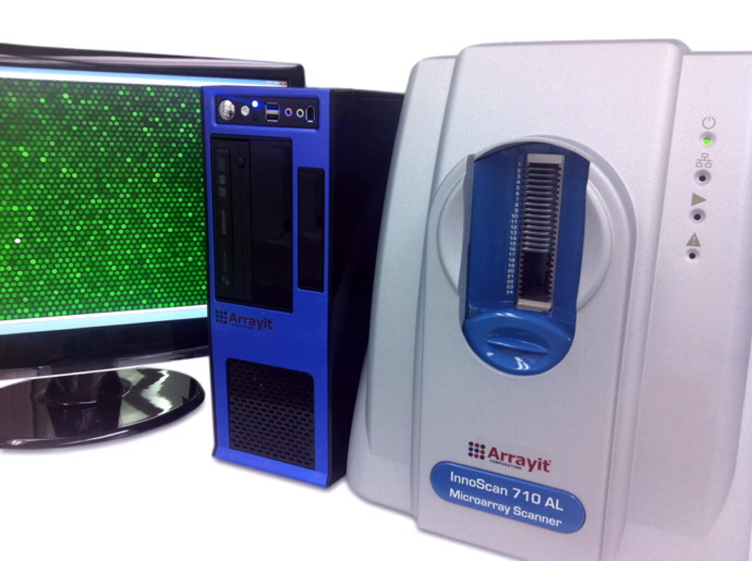
Microarray

Slide 18
Sequencing

Slide 19
Sequencing - Sanger
https://www.gatc-biotech.com/en/expertise/sanger-sequencing.html

Slide 20
Sequencing - Sanger
ucsf.edu, genomelegacy.org/img/DNA-Sequencers.jpg

Slide 21
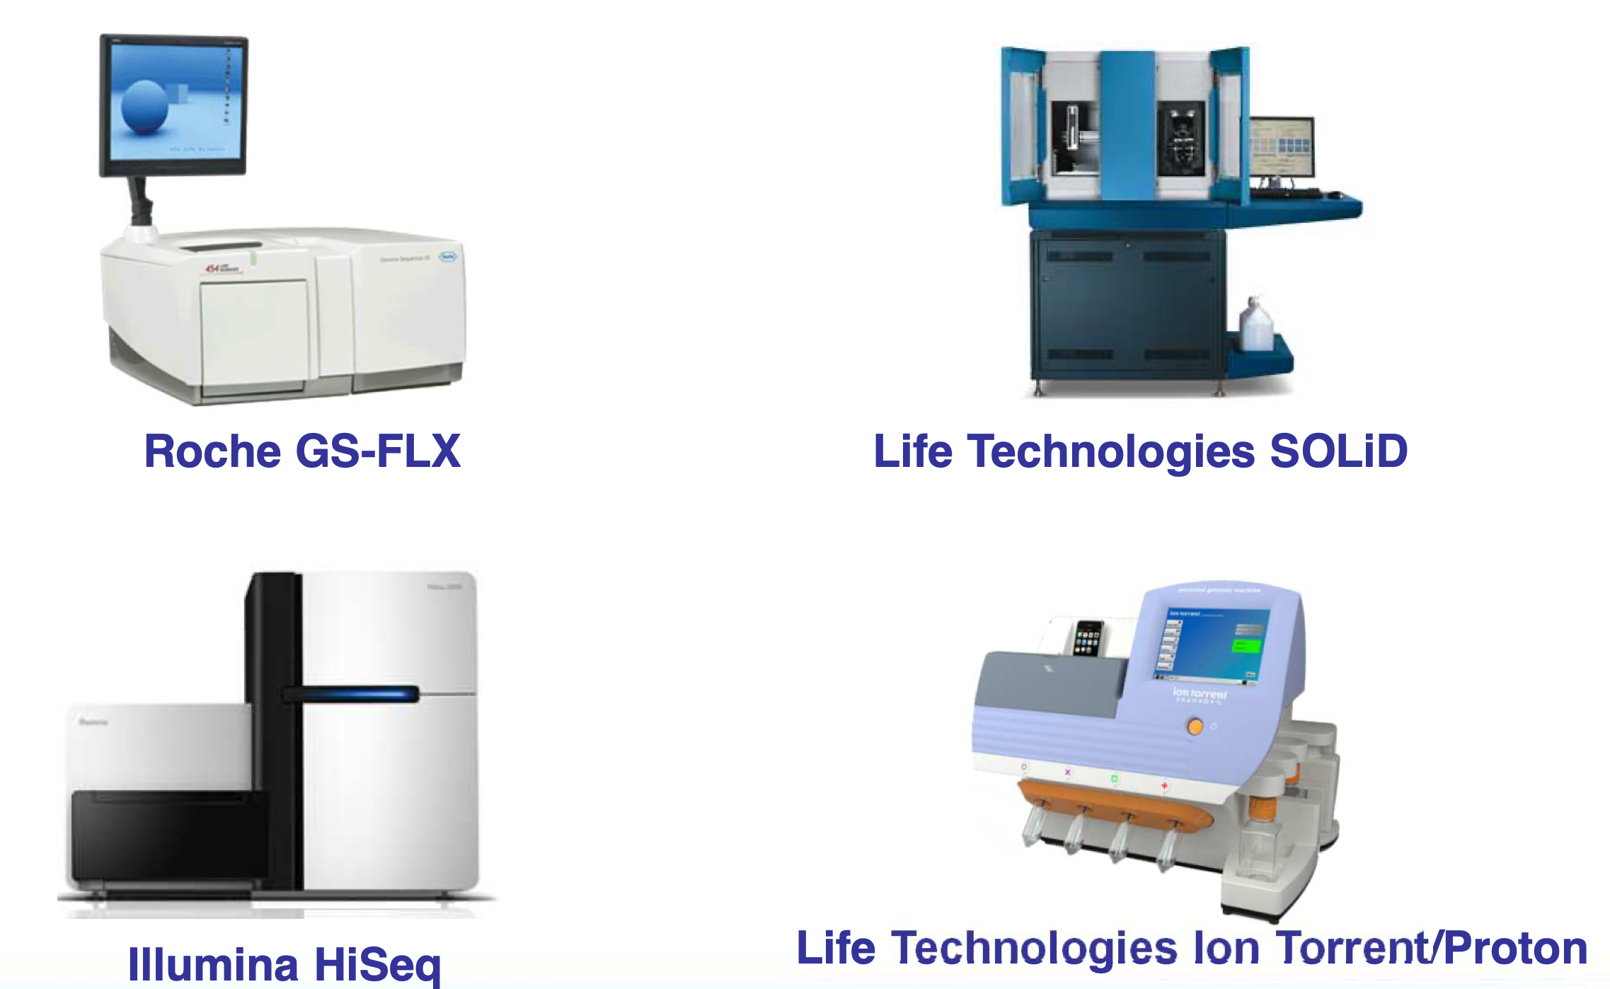
Next Generation Sequencing (NGS)

Slide 22
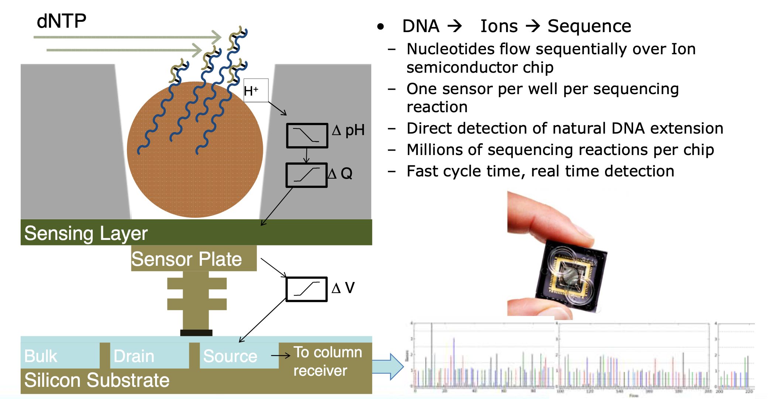
Ion Torrent

Slide 23
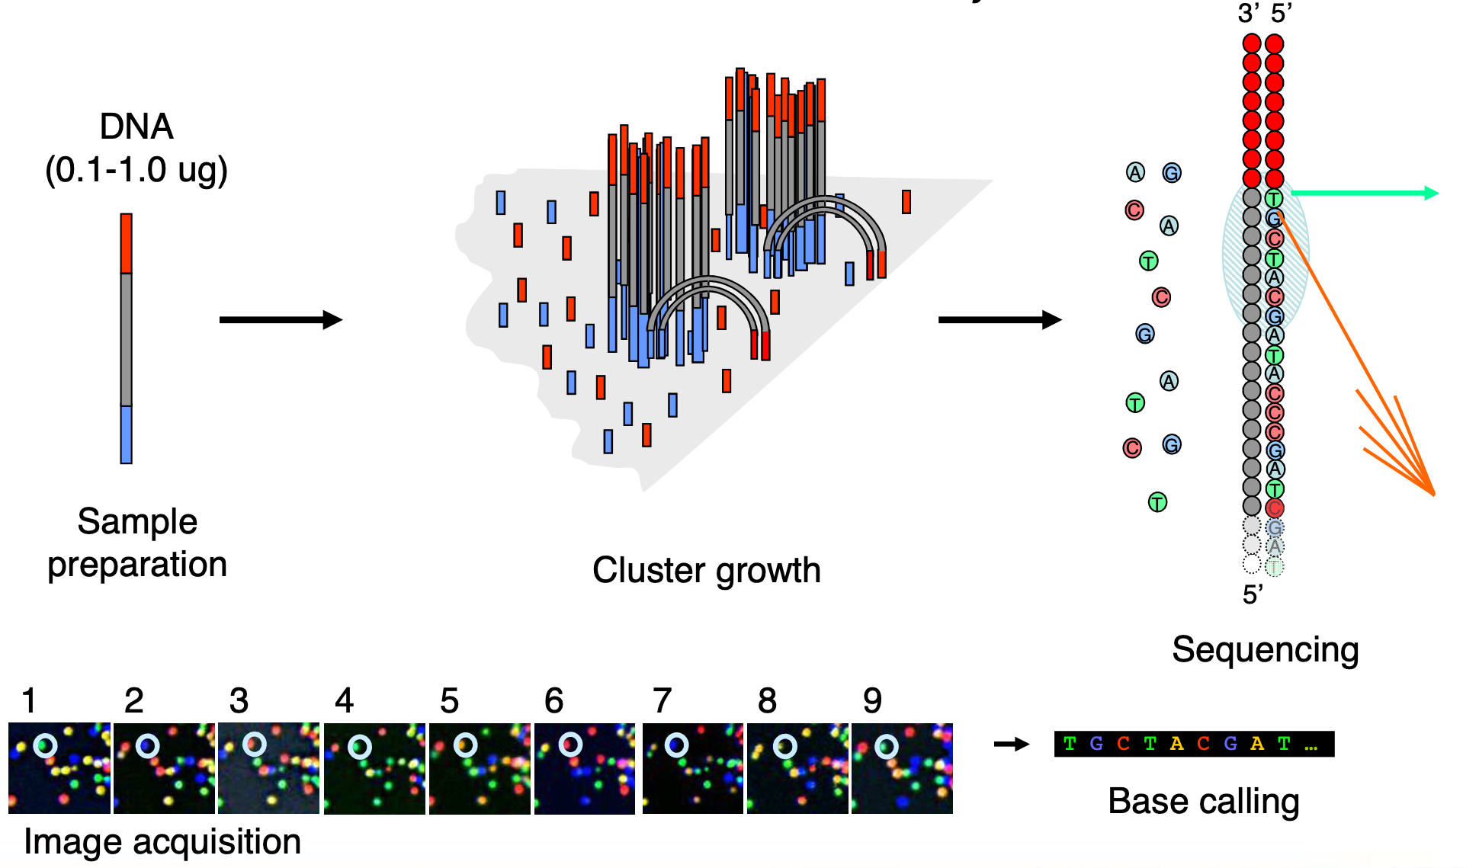
Illumina

Slide 24
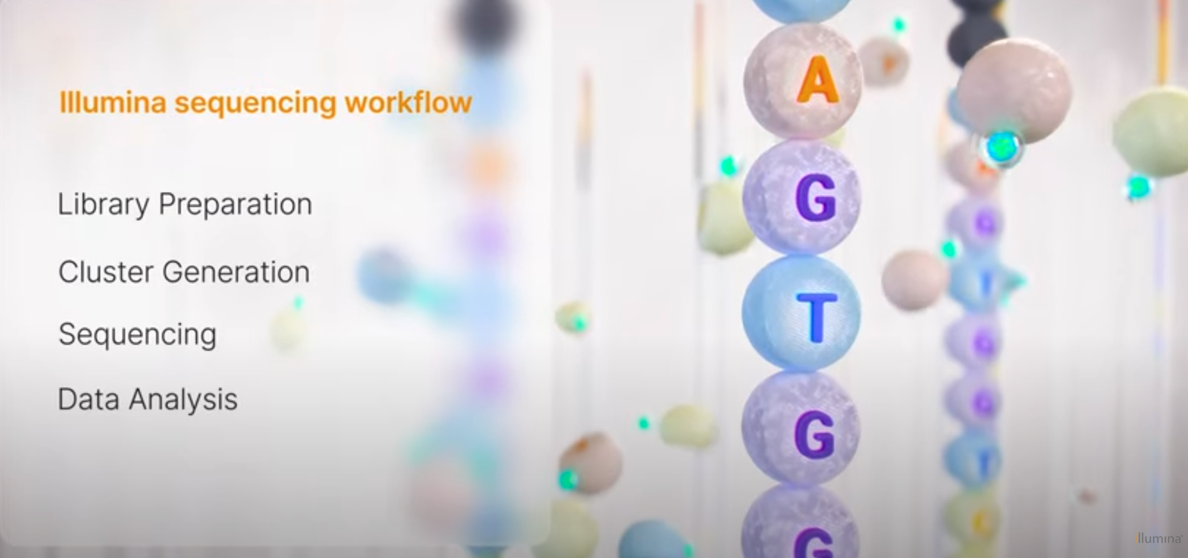
Illumina (video)
https://www.youtube.com/watch?v=EDVKxSNdSic

Slide 25
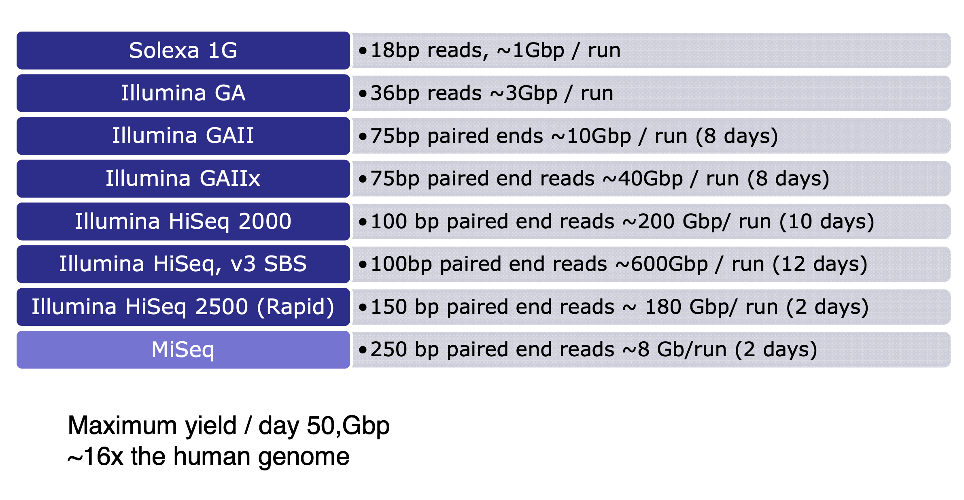
Illumina

Slide 26
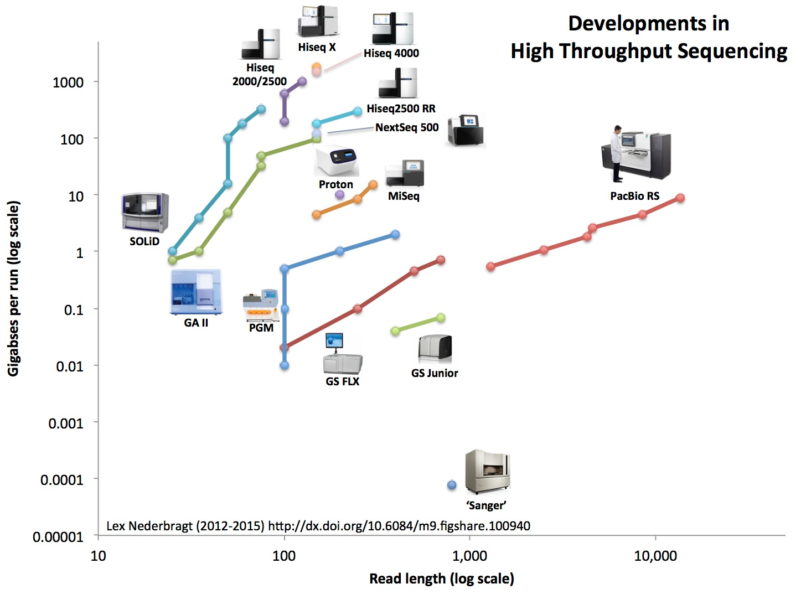
NGS Throughput
https://flxlexblog.files.wordpress.com

Slide 27
NGS Cost
https://www.genome.gov

Slide 28
Illumina HiSeq X
http://cen.acs.org

Slide 29
Throughput
24 Hours
709 Years

Slide 30
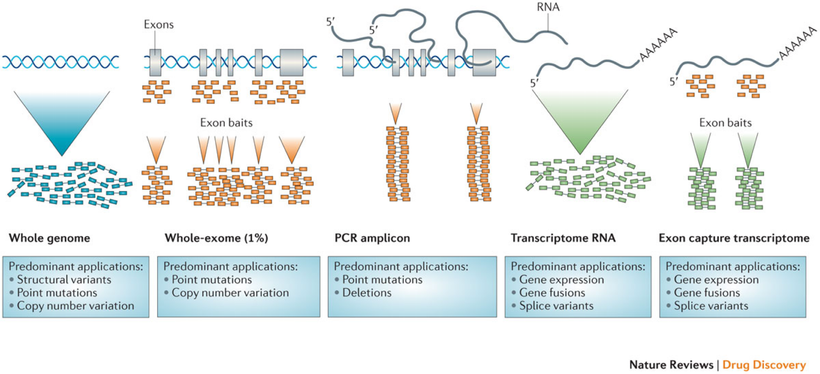
Applications

Slide 31
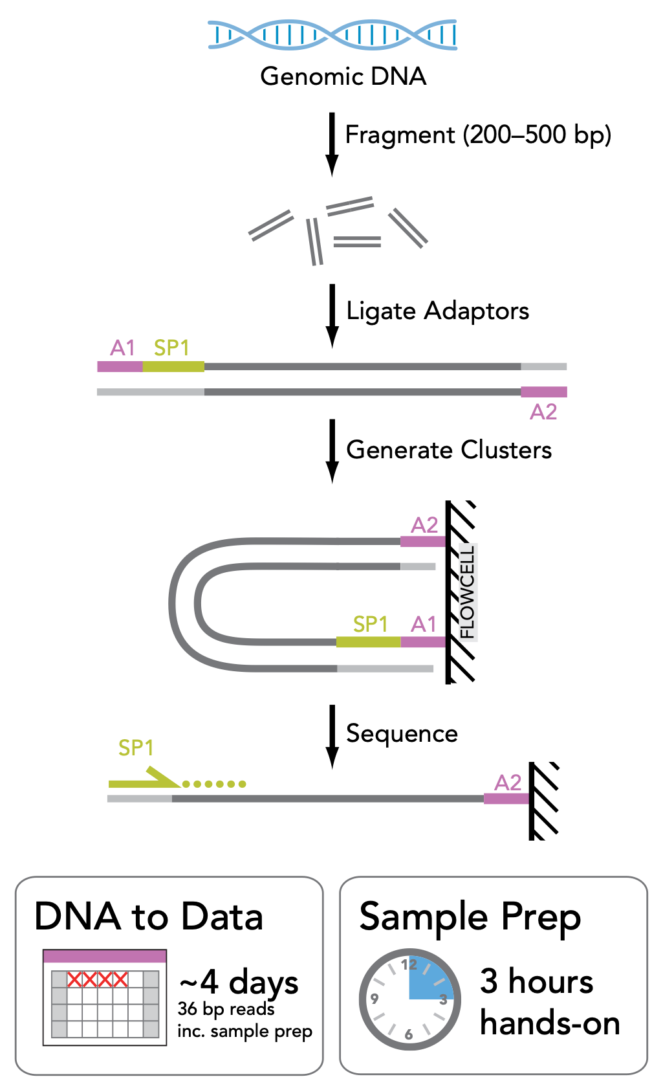
Single-end
Illumina sequencing datasheet

Slide 32
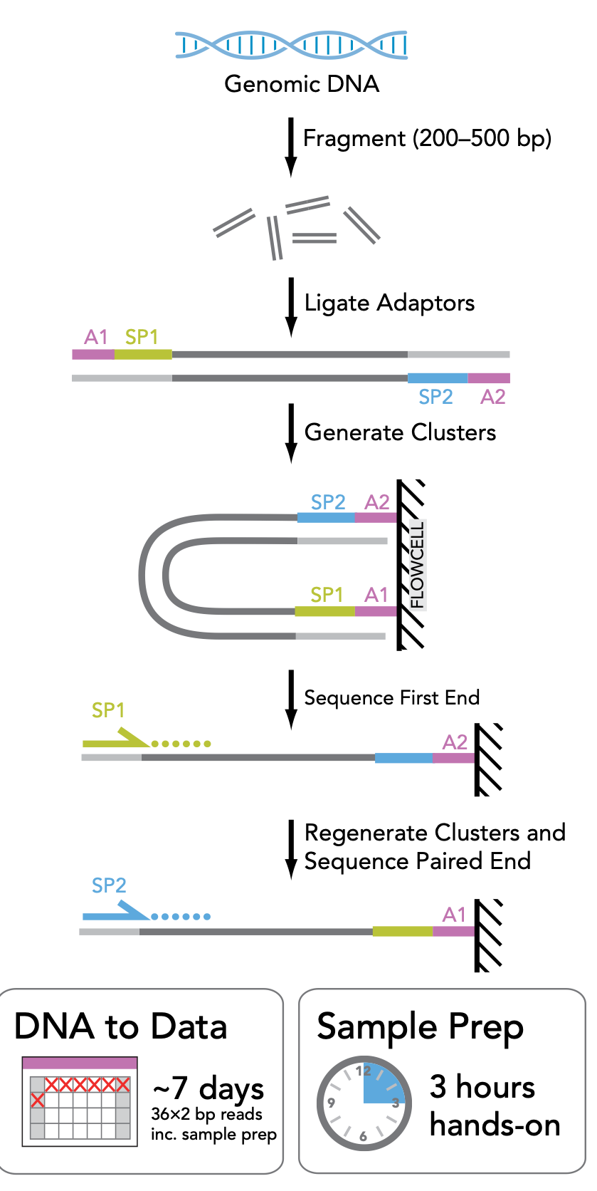
Paired-end
Illumina sequencing datasheet

Slide 33
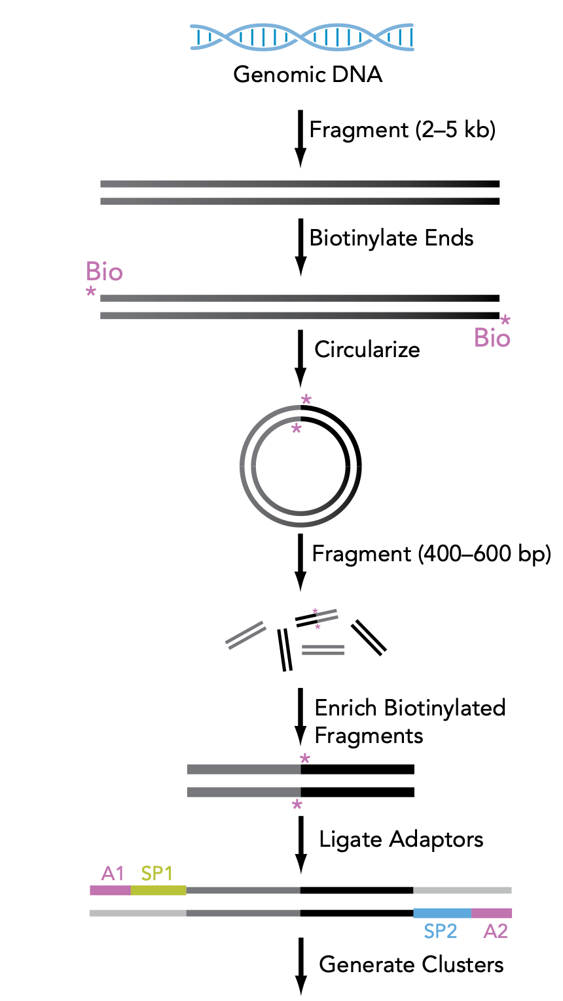
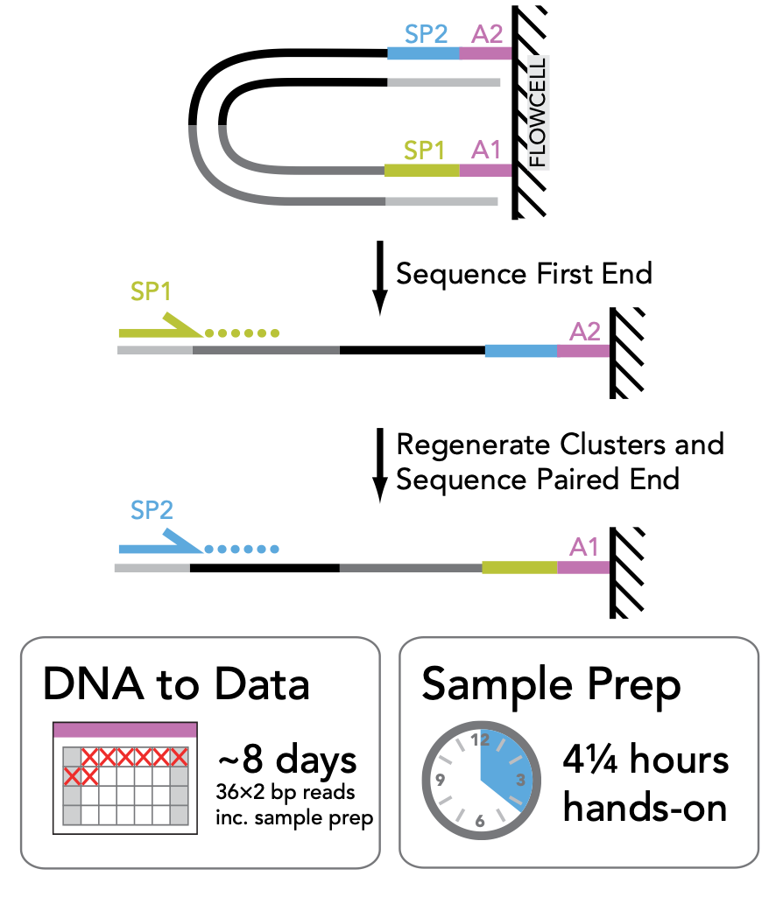
Mate-pairs
Illumina sequencing datasheet

Slide 34
Alignment

Slide 35
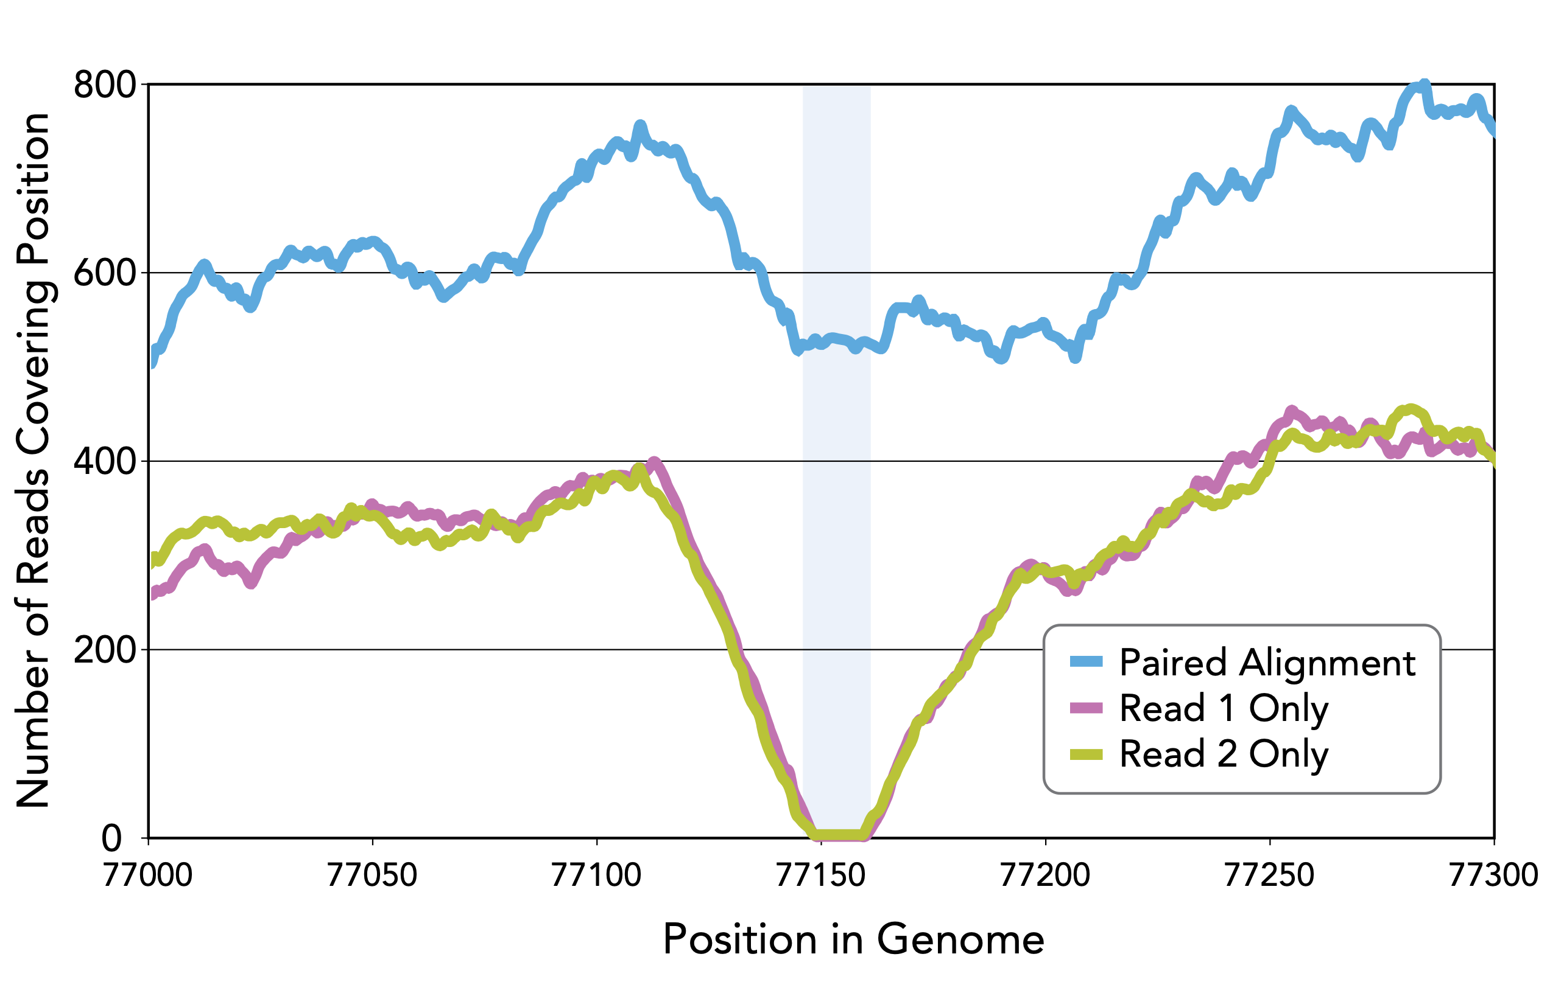
Paired-end vs. Single-end
Illumina sequencing datasheet

Slide 36
Bioinformatics Analysis

Slide 37
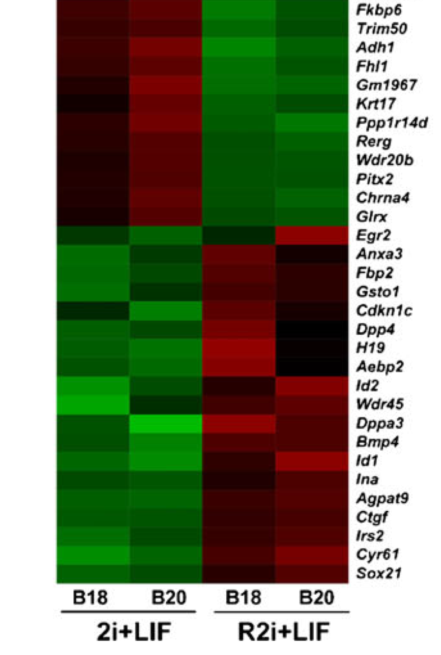
Gene Expression Analysis

Slide 38
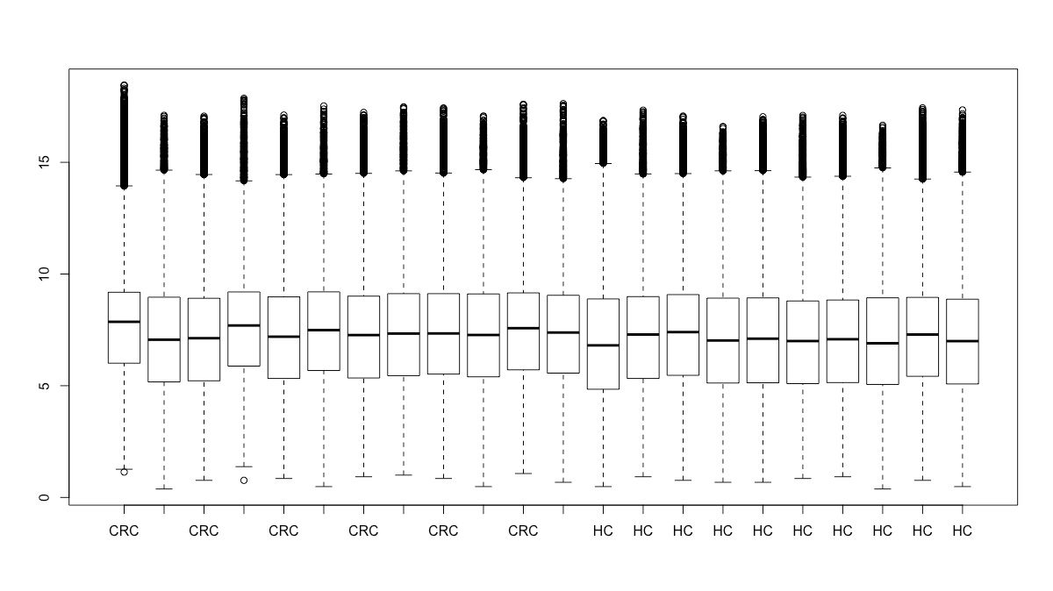
Gene Expression Analysis

Slide 39
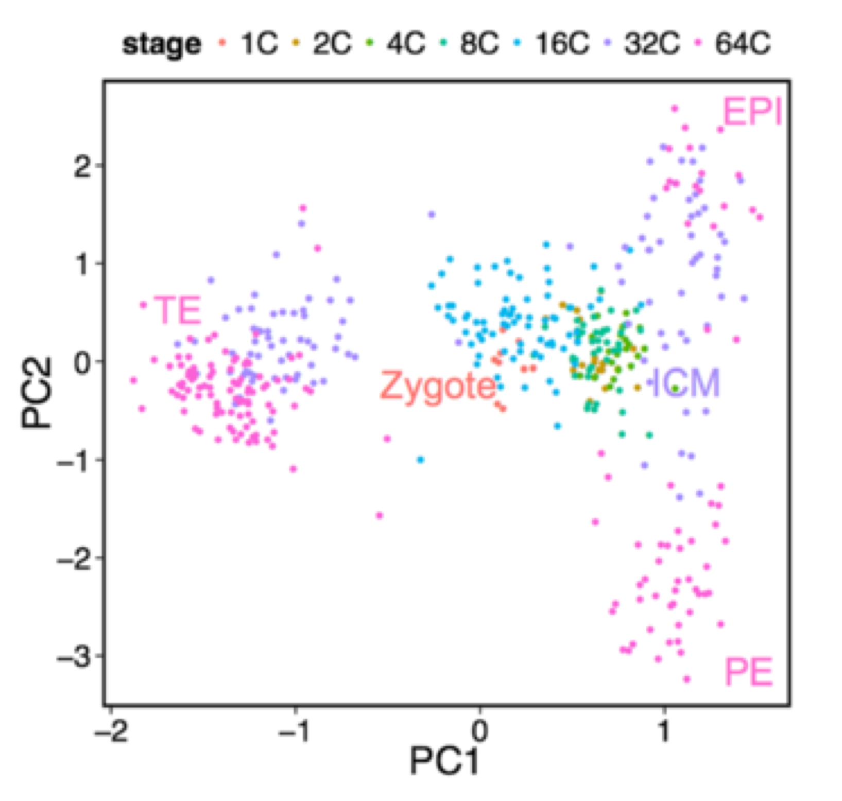
Gene Expression Analysis

Slide 40
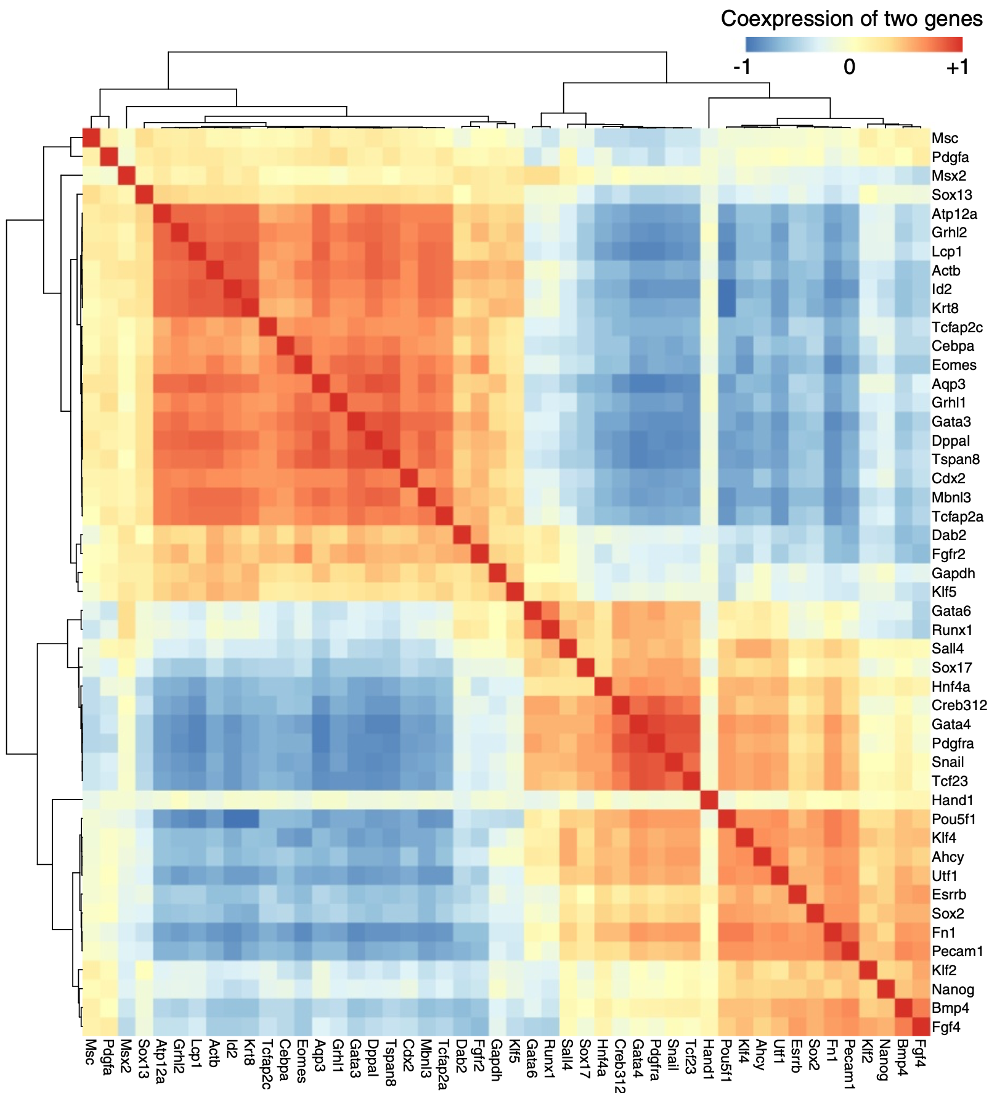
Gene Expression Analysis

Slide 41
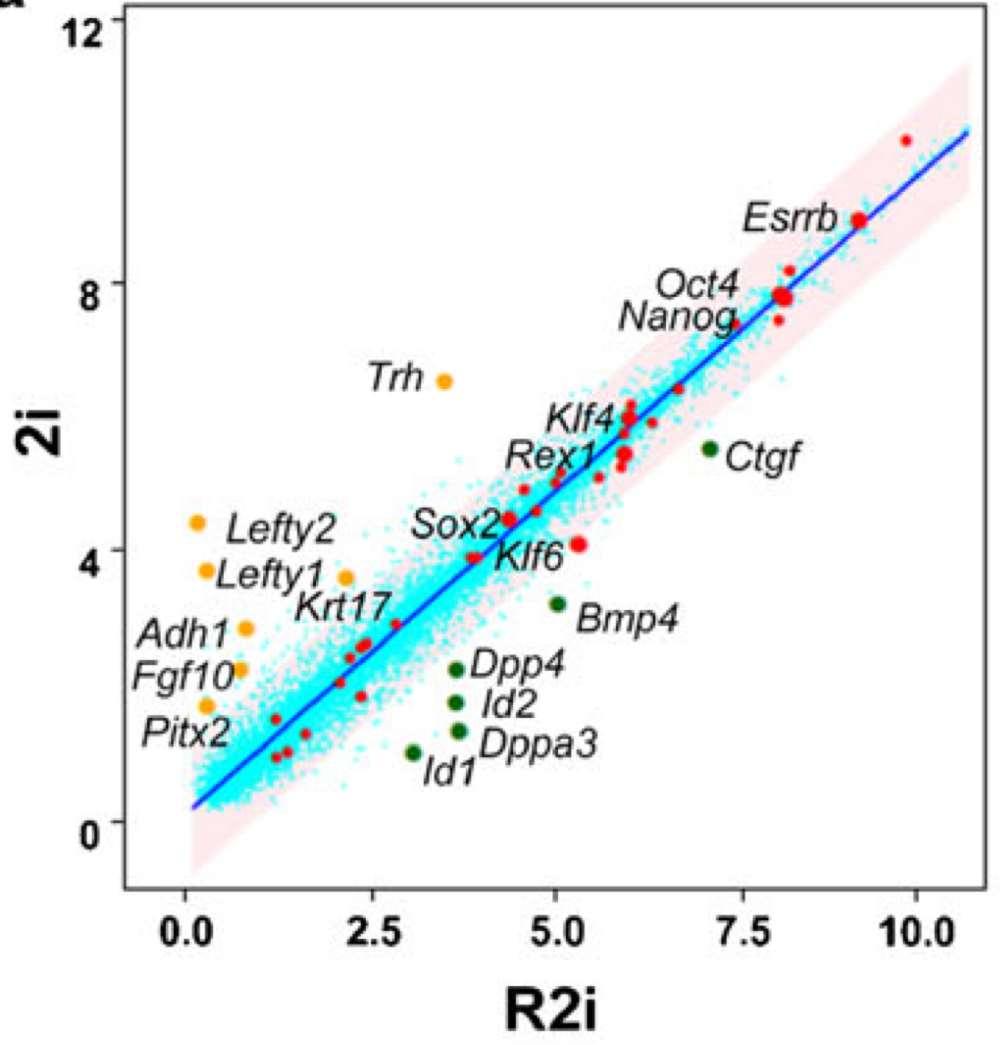
Gene Expression Analysis

Slide 42
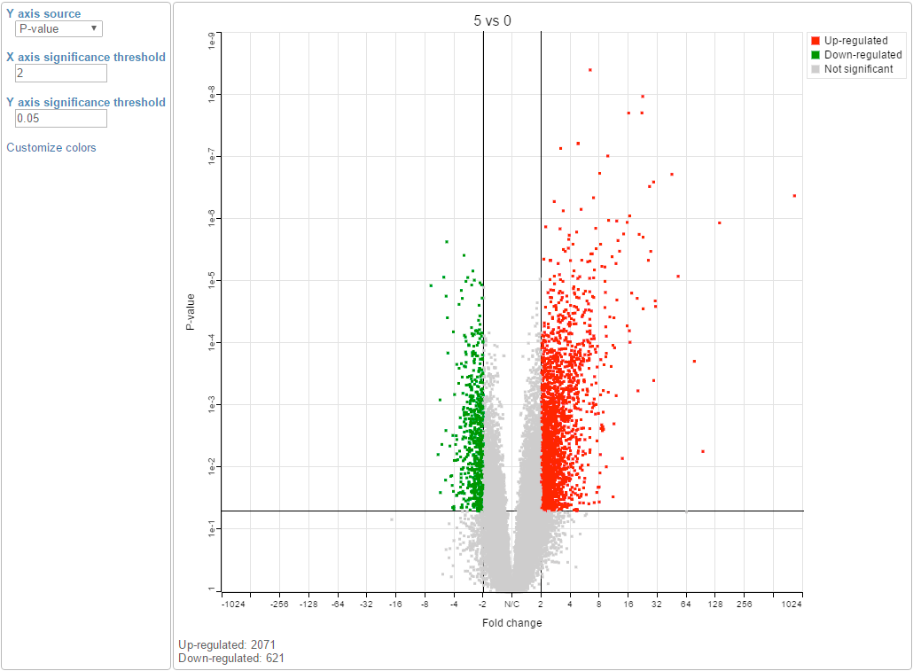
Gene Expression Analysis

Slide 43
Gene Ontology
http://geneontology.org/page/ontology-structure

Slide 44
Pathways
A. Fleming, et al., Nature Chemical Biology 7, 9–17 (2011)

Slide 45
Analysis Pipeline
Sample Preparation
Sequencing
Quality Control
Reference Genome Available?
Yes
No
Alignment
Assembly
Variation Detection
Peak Finding
Expression Analysis
Gap Filling
SNV, CNV, Indelds
TFBS,
Histone Codes
Expression Level DE Genes
Reference Genome

